Slide 1
Laudes Foundation
Partner Portal User Guide

Slide 2
Partner Portal User Guide
01 How to set up your account
02 How to access the Partners Portal
03 How to submit a report
04 Getting help

Slide 3
01 How to set up your account

Slide 4
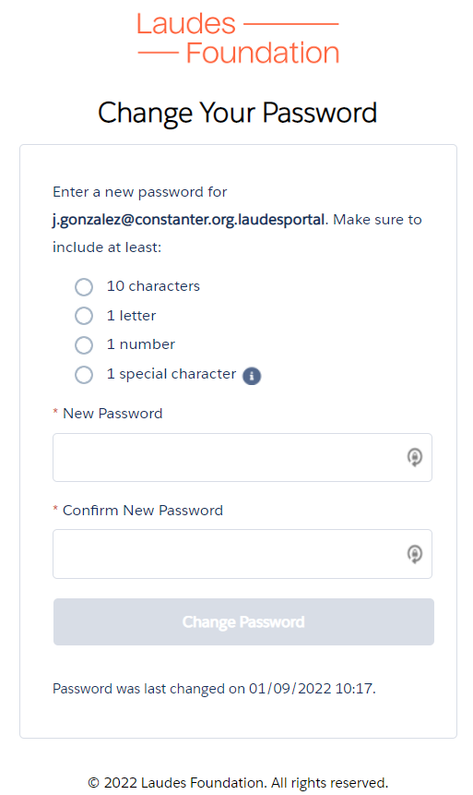
How to set up your account
Once you have been given access to the Partners Portal, you will receive an email to set your password (in case you haven’t received an email, please also check your spam mail).
Please click on the link to set your password.
3. You will be redirected to this page where you can set up your password.
Your username is always as follows: email.laudesportal
(e.g. laudes@laudes.org.laudesportal)

Slide 5
02 How to access the Partner Portal

Slide 6
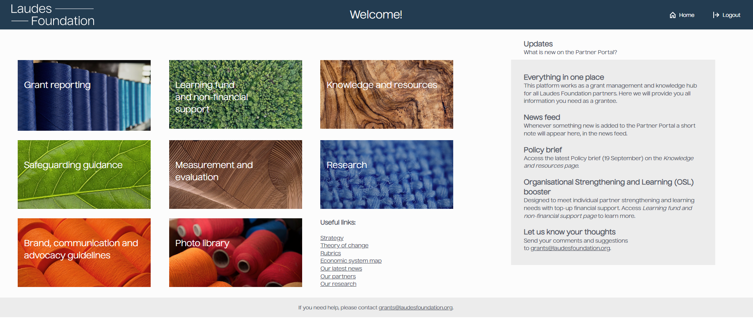
How to access the Partner Portal
Click on this link to access the Partners Portal: https://partnerportal.laudesfoundation.org
Click on Grant Reporting to access your account and log in using your username (email.laudesportal) and password.

Slide 7
03 How to submit a report

Slide 8
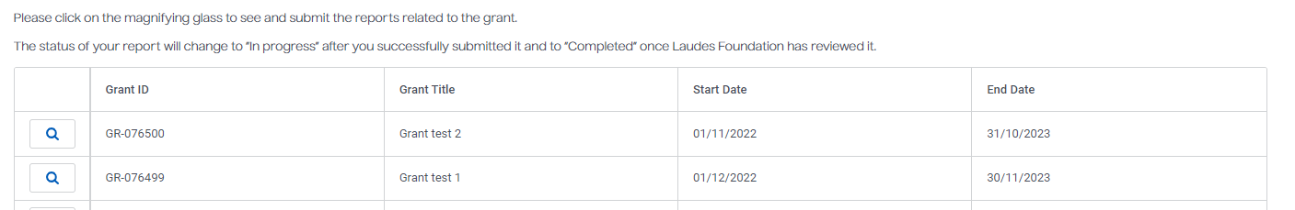
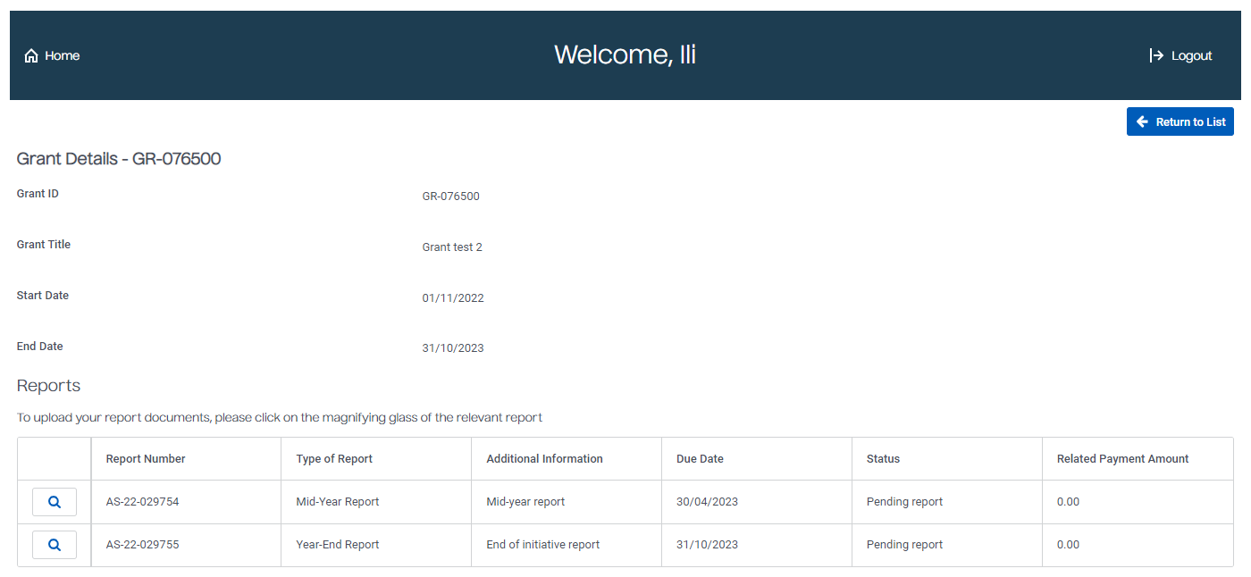
How to submit a report
1. Once you are logged into your account, you will be able to see a list of your grant(s).
2. Please click on the magnifying glass next to the grant you would like to submit a report to. As an example, we will use the Grant test 2. Now all the reports linked to the Grant test 2 appear.

Slide 9
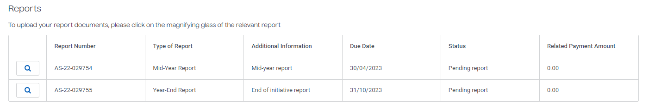
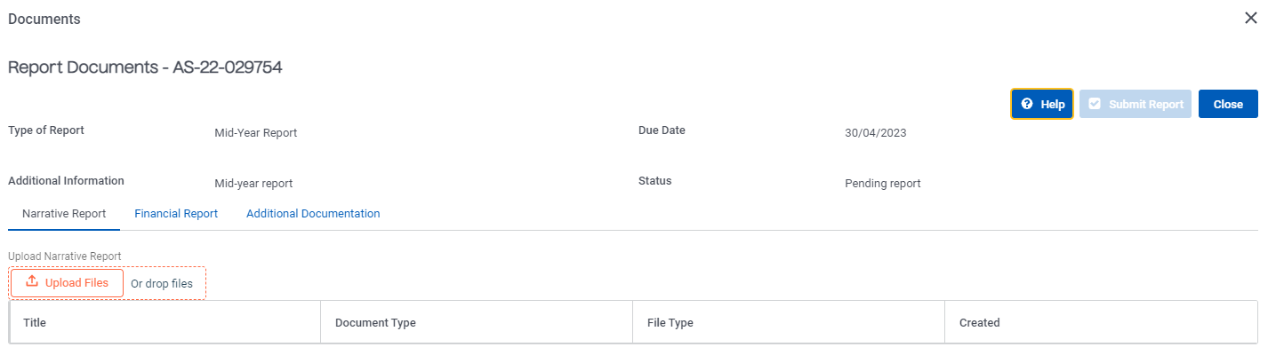
How to submit a report
3. Please click on the magnifying glass, next to the name of report you would like to submit.
4. Next, please click on the type of report you would like to submit.

Slide 10
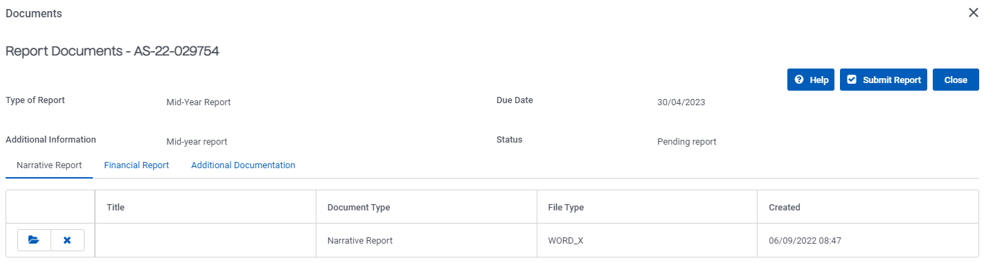
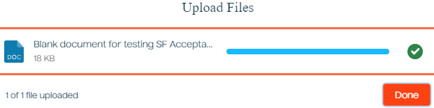
How to submit a report
5. Once you have selected the type of report, please click on Upload Files or Drop files.
6. Add the relevant report , click on Done and then on Submit report.

Slide 11
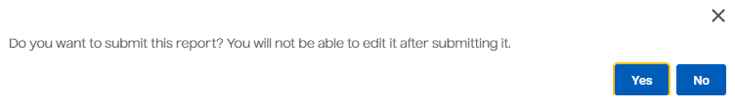
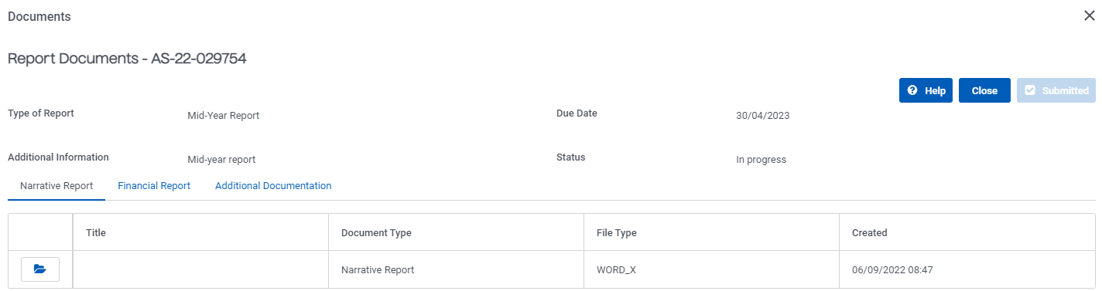
How to submit a report
7. To finalise the upload, please confirm that you would like to submit the report.
8. Now, your report has been uploaded to the Partners Portal. To go to the next step, please click on Close.

Slide 12
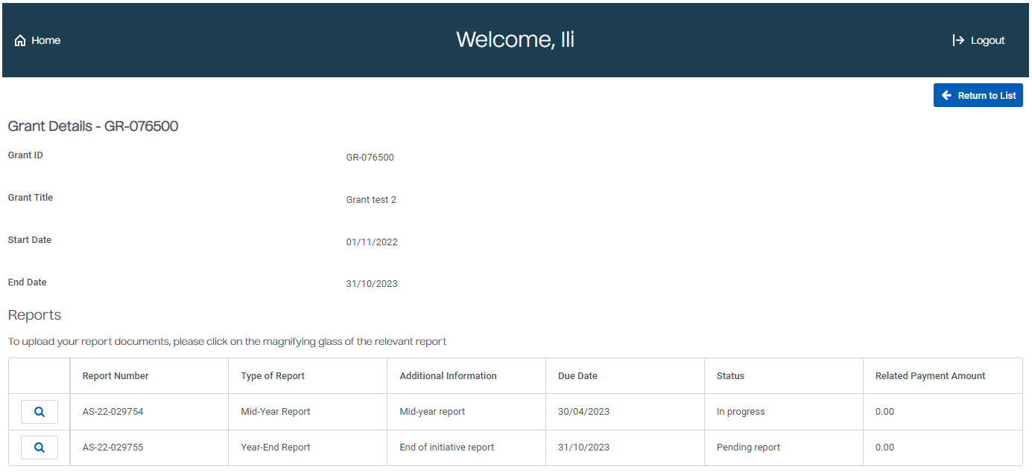
How to submit a report
9. The status of the report you submitted will be automatically changed from Pending report to In progress.
Congratulations, you have successfully uploaded your report! The Programme Manager will receive an email informing them that you have submitted a report.
If you wish to go back to the list of active grant(s) you currently have with Laudes Foundation, please click on Return to List (on the top right of your screen)

Slide 13
04 Getting help

Slide 14

Getting help
Reach out to the Grant Administration team by
sending an email to grants@laudesfoundation.org

